Slide 1
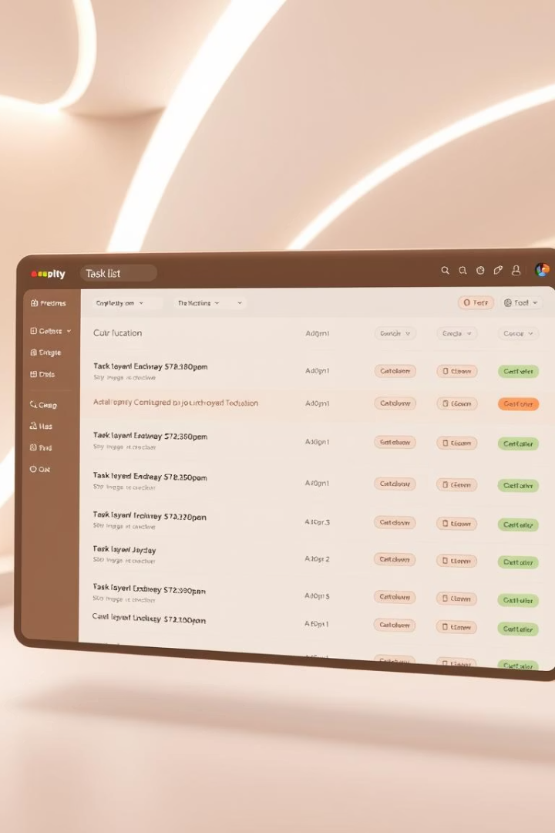

Task Management Web App — Internship Project Genesys
Welcome to the presentation on my internship project: a full-stack task management web application built using the MERN stack. This project showcases my abilities in developing robust and interactive web solutions.
by Faisal Jabbar
1

Slide 2

Project Overview
Task Management Web Application
Internship Assessment — FAST University
Faisal Jabbar
Intern Developer
MERN Stack
MongoDB, Express, React, Node.js

Slide 3
Project Goal and Purpose
Purpose
Main Goal
Full-stack task manager for authenticated users.
Demonstrate MERN skills with key functionalities.
Create and edit tasks.
Real-time state management.
Update and delete tasks.
Efficient routing implementation.
Mark tasks as complete.
3

Slide 4
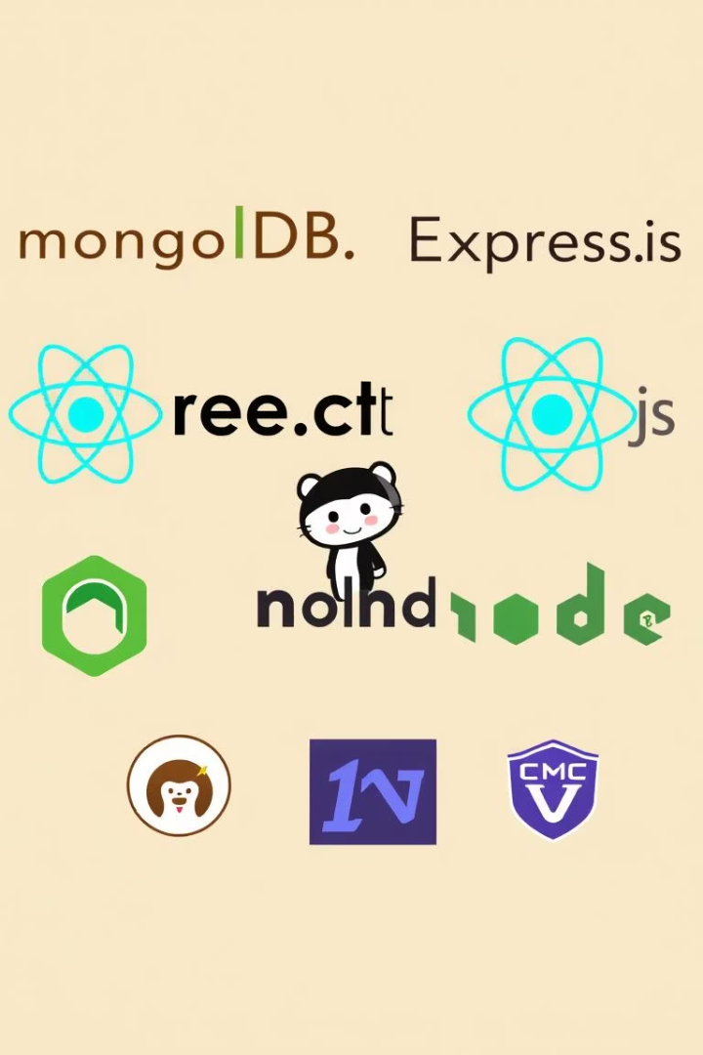

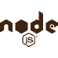


Core Technologies
React Frontend
Node.js & Express.js
MongoDB Database
Dynamic UI with Bootstrap.
Robust backend server.
Localhost for data storage.
JWT Authentication
Secure user access.

Slide 5
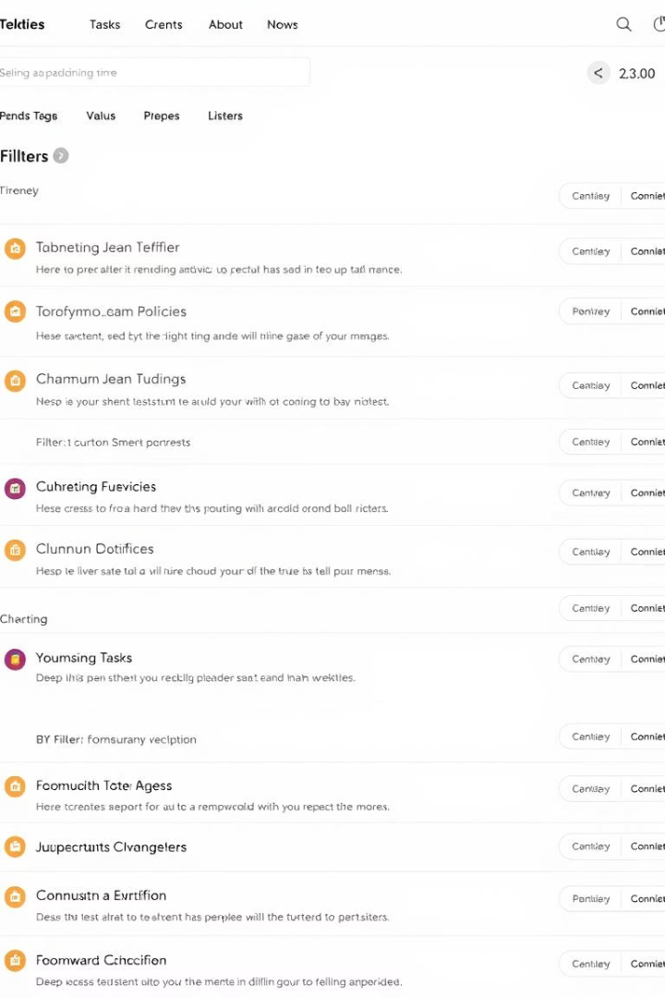
Key Features Implemented
User Management
Signup, Login, Logout.
Secure Access
Token-based Authentication.
Task Operations
Create, Edit, Delete, Toggle.
User Experience
Filtering and Responsive UI.

Slide 6
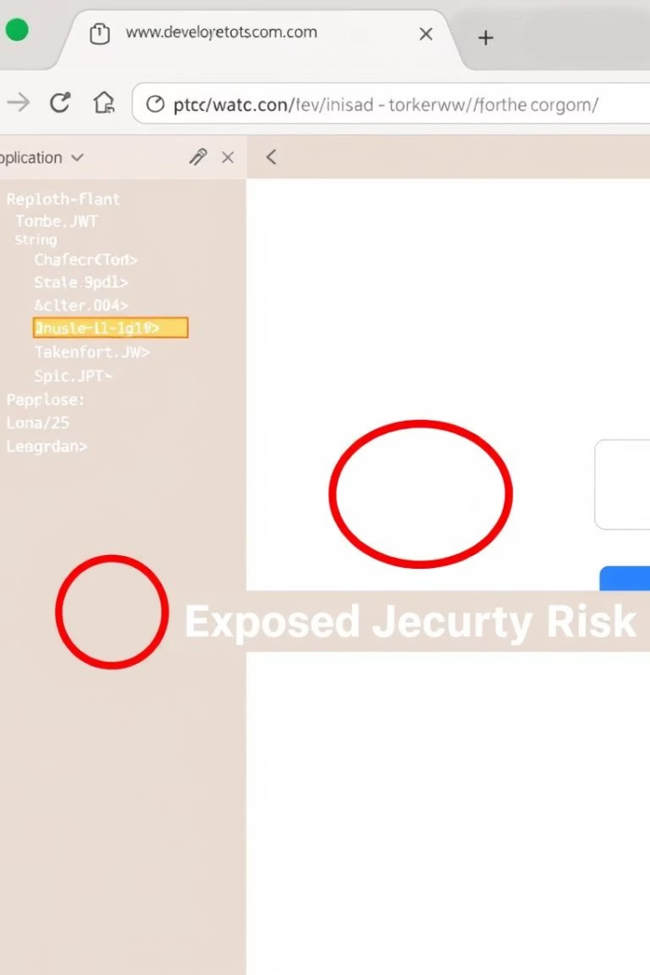




Authentication System Details
JWT Token Storage
Stored securely in localStorage.
Context API
Manages authentication state.
Protected Routes
PrivateRoute ensures authorized access.
Logout Functionality
Clears state and token on logout.
6

Slide 7






Task Management Functionality
CRUD Operations
Full control over tasks.
Intuitive UI
Comprehensive task form.
Data Validation
Mongoose schema enforcement.
7

Slide 8

Challenges and Solutions
1
Email Feature Issues
Difficulty with integration.
2
Reason for Challenge
Limited NodeMailer experience.
3
Planned Resolution
Future NodeMailer integration.
8

Slide 9
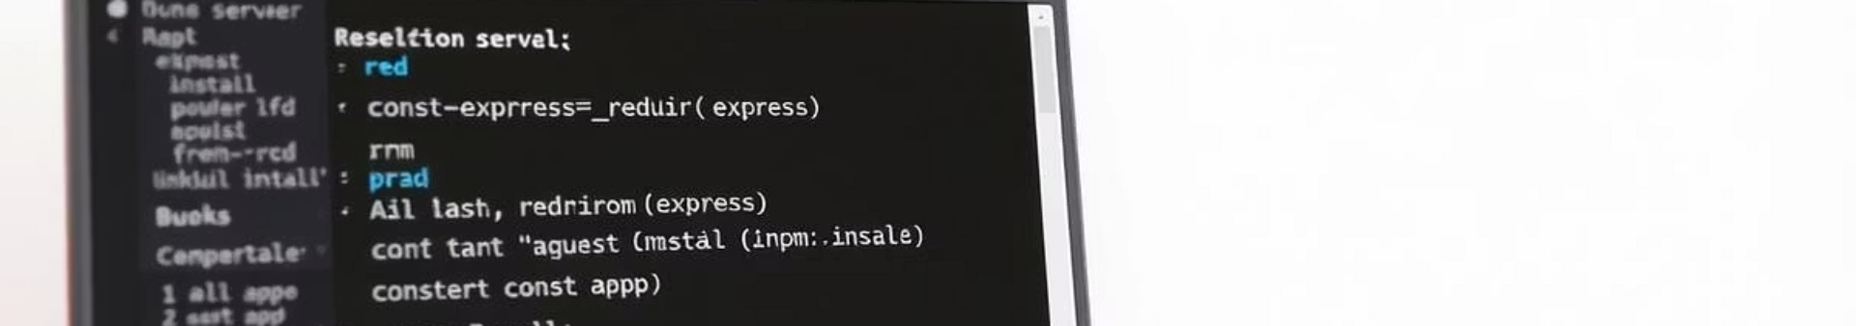
Local Deployment Steps
Start Backend
Backend Setup
Execute 'node server.js'.
Navigate to 'backend', run npm install.
Start Frontend
Frontend Setup
Execute 'npm start'.
Navigate to 'frontend', run npm install.
9

Slide 10

Conclusion and Key Learnings
1
2
3
Full-Stack Skills
Secure Auth
DevOps Practice
Hands-on development experience gained.
Implemented a robust authentication system.
Strengthened debugging and Git usage.
4
Tested Project
Fully functional MERN app on localhost.

Slide 11
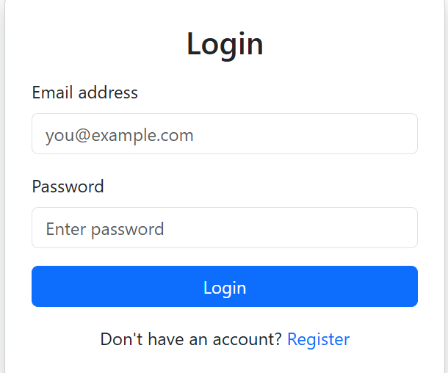
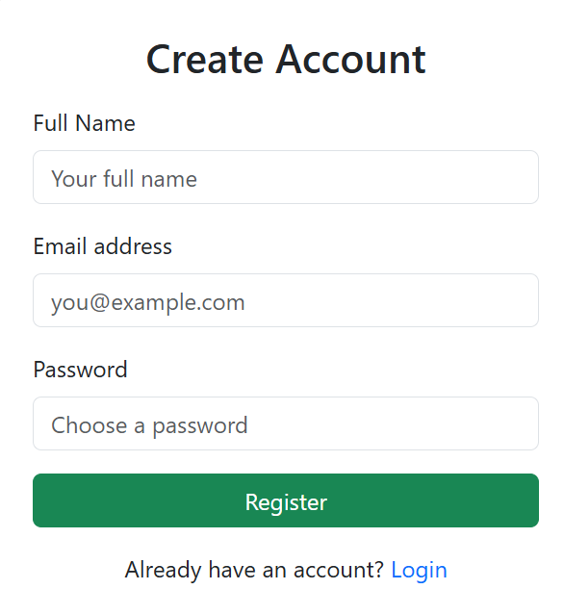

Slide 12
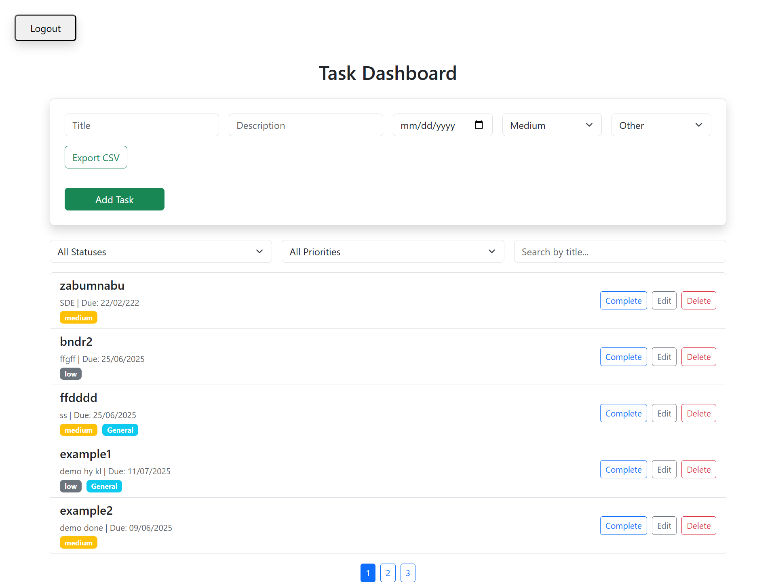
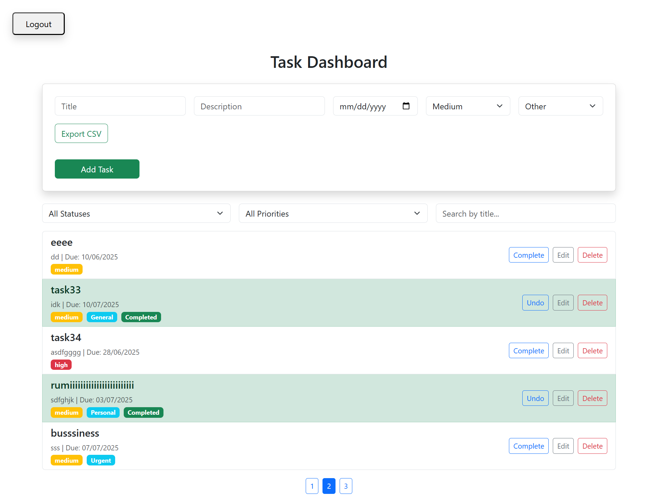
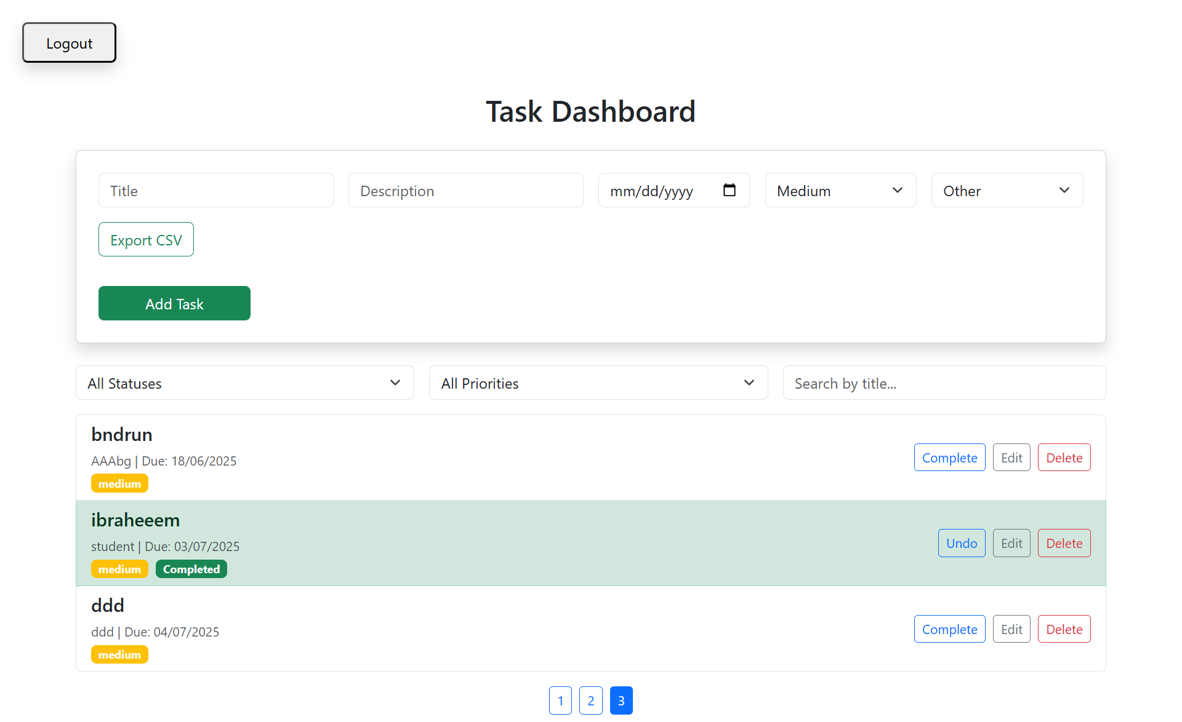
12

Slide 13
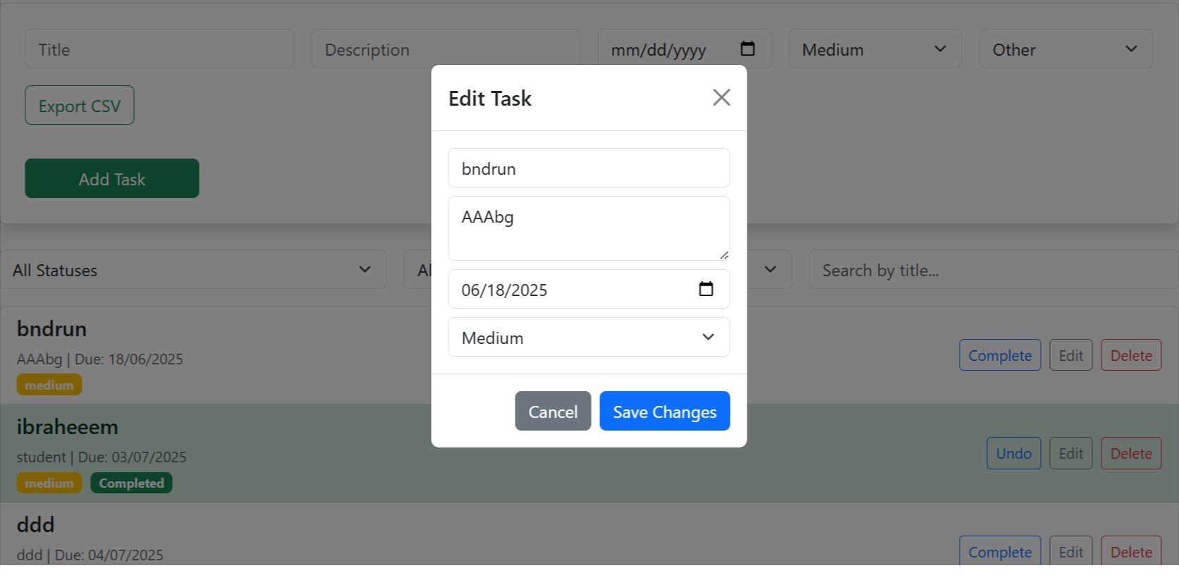
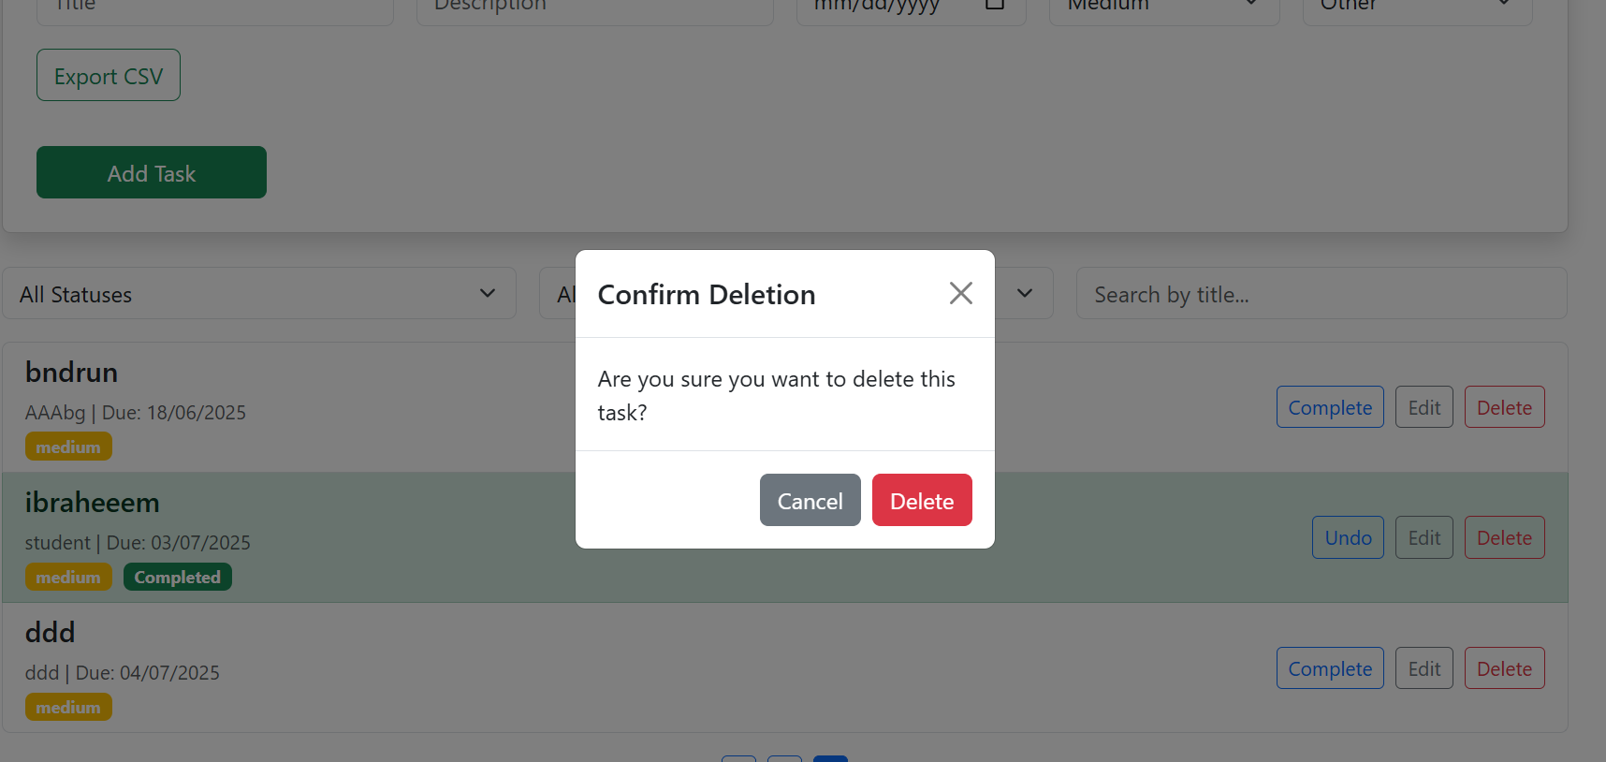
13

Slide 14
THANK YOU
14

